Slide 1

RIM: Robust Intersection Management for Connected Autonomous Vehicles
Mohammad Khayatian, Mohammadreza Mehrabian, Aviral Shrivastava
Arizona State University
Notes:
Hello everyone,
My name is Mohammad Khayatian and I’m a PhD student at ASU. Today, I will present our work on Robust intersection management of Connected Autonomous vehicle.

Slide 2
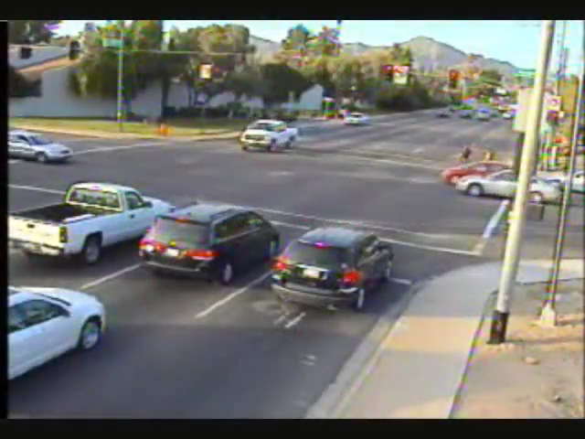
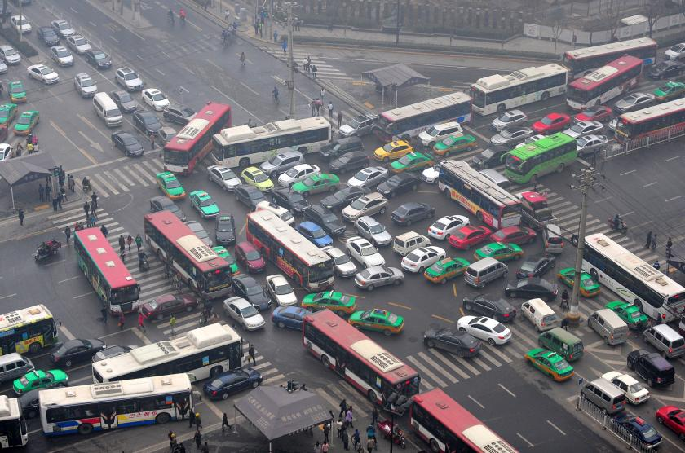
Why Autonomous intersections?
Accidents at intersection
Between 2010 and 2015 , around 30% of fatal crashes have happened in intersection areas, most of which, involved human errors. [FHA]
Traffic Congestion
On the average, each person in the US spends around 42 hours per year stuck in the traffic [FHA]
As cars become autonomous, so too can intersections
Intersection Management using V2I
[FHA] Roadway Safety Data Dashboards, US Department of Transportation - Federal Highway Administration
Notes:
1) Why do we need automated intersections?
2) Let’s start with some statistic:
3) According to the Federal Highway administration, About 30% of fatal accidents has happened in intersection area and most of which involved human errors.
Click.
4) Believe me, you don’t wanna be in any of those cars.
5) Also, on the average, each person in the US spends around 42 hours per year stuck in the traffic
6) These two issues, highlight the need for automation.

Slide 3


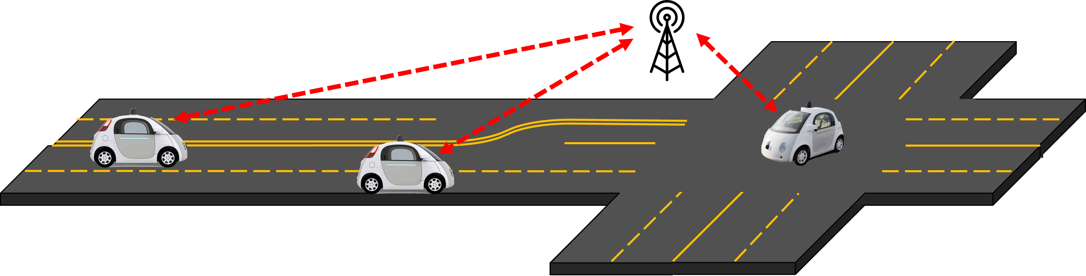
Intersection Manager (IM)
An infrastructure communicating with incoming vehicles.
Contains Multiple computing systems
Real-time communication
Real-time actuation
Safety
Robustness
Intersection Manager
Notes:
1) Implementing a safe autonomous intersection manager is challenging.
2) Because there are multiple computing systems that communicates with each other
3) and, real-time communication, processing and actuation is required.

Slide 4
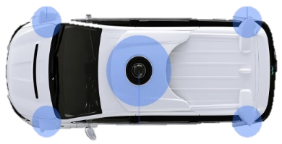
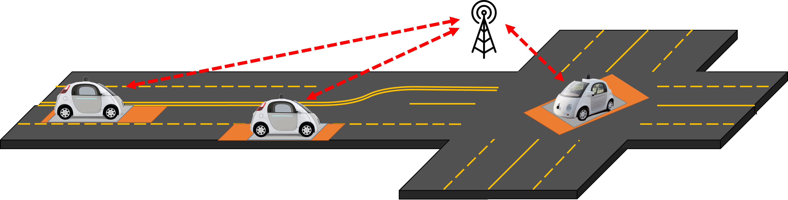
Safety buffer
IM should consider a safety buffer around each vehicle to account for uncertainties in vehicles position
Localization of autonomous vehicle is challenging
$$E_{Long}$$
$$L$$
$$E_{Long}$$
$$E_{Lat}$$
$$W$$
$$E_{Lat}$$
Notes:
The most important aspect of intersection management is safety.
Since localization is not perfect, IM needs to account for uncertainties in the position by considering a safety buffer around a car.

Slide 5
Existing Approaches
Query-based Intersection Management (QB-IM)
Vehicles send estimated time of arrival and velocity of arrival to IM
IM accepts/rejects the request
AIM (Autonomous Intersection Management) [1]
Velocity Assignment Intersection Management (VA-IM)
Vehicles send their position and velocity
A target velocity is assigned to the vehicle
Cooperative Vehicle Intersection Control (CVIC) [2]
[1] Dresner, Kurt, and Peter Stone. "A multiagent approach to autonomous intersection management." Journal of artificial intelligence research 31 (2008): 591-656.
[2] Lee, Joyoung, and Byungkyu Park. "Development and evaluation of a cooperative vehicle intersection control algorithm under the connected vehicles environment." IEEE Transactions on Intelligent Transportation Systems 13.1 (2012): 81-90.
Notes:
1) Many intersection management techniques have been proposed so far.
2) and we categorize them as Query-based approaches or QB-IM and Velocity assignment approaches or VA-IM.
3) In Query-based approaches, a vehicle that approaches the intersection, sends its estimated time of arrival and velocity of arrival to the IM
4) and, IM simulate the future trajectory of the vehicle inside the intersection and accordingly, replies a Yes to the vehicle if the trajectory doesn’t have any conflicts with existing vehicles is safe.

Slide 6
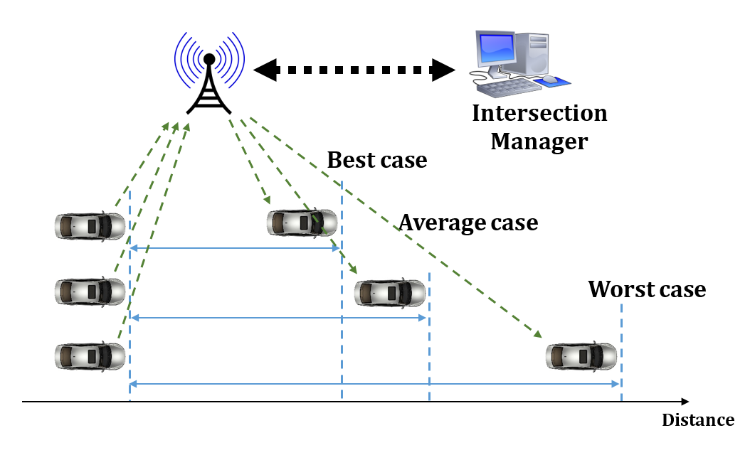
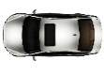
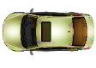
QB-IM (Query-based Intersection Management)
t=0
t=1
t=2
t=3
t=4
t=5
t=6
t=7
Intersection Manager
yes
Not efficient
Request Line
Enter
Exit
[1] Dresner, Kurt, and Peter Stone. "A multiagent approach to autonomous intersection management." Journal of artificial intelligence research 31 (2008): 591-656.

Slide 7
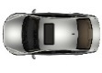
VA-IM (Velocity Assignment Intersection Management)
Intersection Manager
Better Efficiency
$V_{T}=$ 8.5 m/s
$V_{0}=$ 10.2 m/s
Request Line
Enter
Exit
[1] Lee, Joyoung, and Byungkyu Park. "Development and evaluation of a cooperative vehicle intersection control algorithm under the connected vehicles environment." IEEE Transactions on Intelligent Transportation Systems 13.1 (2012): 81-90.

Slide 8
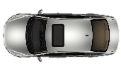
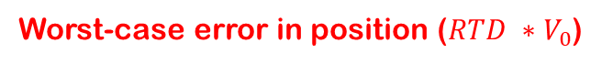
Timing Problem in VA-IM
Round Trip Delay (RTD) due to communication is ignored.
Inconsistency between vehicle position and what IM thinks
Request Line
IM
Best
Worst
Average
Worst-case error in position ($RTD ∗V_{0}$)
Expected Receive Position
Actual Receive
Position

Slide 9
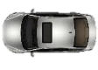
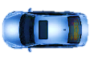
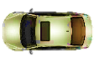
Ignoring RTD Will Cause Crashes
Intersection Manager
Accidents will happen!
$${V_{T}=9.5}_{}$$
$${V_{0}=10.2}_{}$$
Request Line

Slide 10
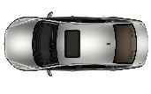
Crossroads Technique
IM sets the execution location to be a fixed value as:
$$ActuationPosition=Request Position +(V_{max}×WCRTD)+b$$
Request Position
Actuation Position
IM
Best
Worst
b
Actuation Begins…
Actuation Begins…
[1] Andert, Edward, Mohammad Khayatian, and Aviral Shrivastava. "Crossroads: Time-Sensitive Autonomous Intersection Management Technique." Proceedings of the 54th Annual Design Automation Conference 2017. ACM, 2017.

Slide 11
Issues of Crossroads
Actuation Position
Velocity
Safety-related
1) Vehicles are assumed to have zero actuation time
2) Assigned velocity will be maintained until entering the intersection
What if a disturbance is applied to the vehicle?
Wind, bump, etc.
Target Velocity
time
Request Line
Edge of the intersection
Actuation Position
Velocity
Target Velocity
time
Request Line
Edge of the intersection

Slide 12
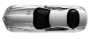
Issues of Crossroads
Low Performance
A constant Velocity is assigned.
To avoid rollover, turn speed is low.
Vehicles that intend to make a turn will slow down others.

Slide 13

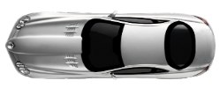
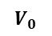
RIM Overview
Intersection Manager
Request Line
Request
Synchronization Line
Response
Sync
Request
TOA & VOA
Track the trajectory
Maintain the velocity
Velocity
Find the optimal trajectory
VOA
$$V_{0}$$
time
Phase 1
Phase 2
Phase 3
Phase 4
TOA

Slide 14
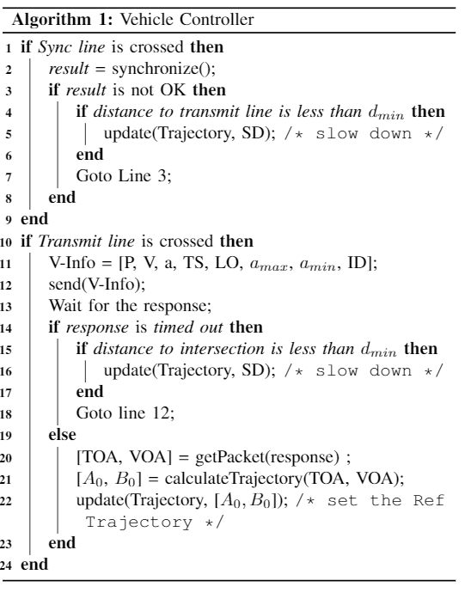
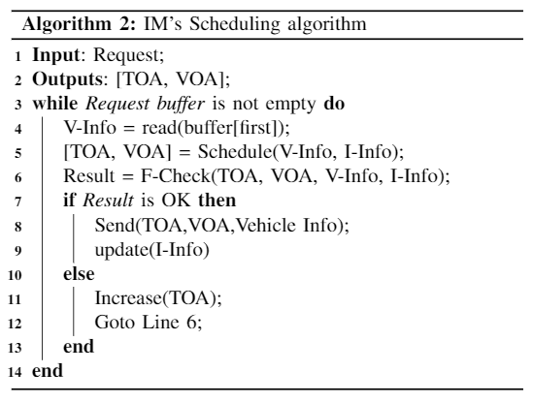
Our Approach: RIM
Vehicle
IM
1) Clock Sync
3) Send a request to IM
8) Find an optimal trajectory
9) Inform IM
9) Track the trajectory
2) Clock Sync
4) Checks for conflicts
5) Check the feasibility
6) Send TOA and VOA
11) Store it.

Slide 15
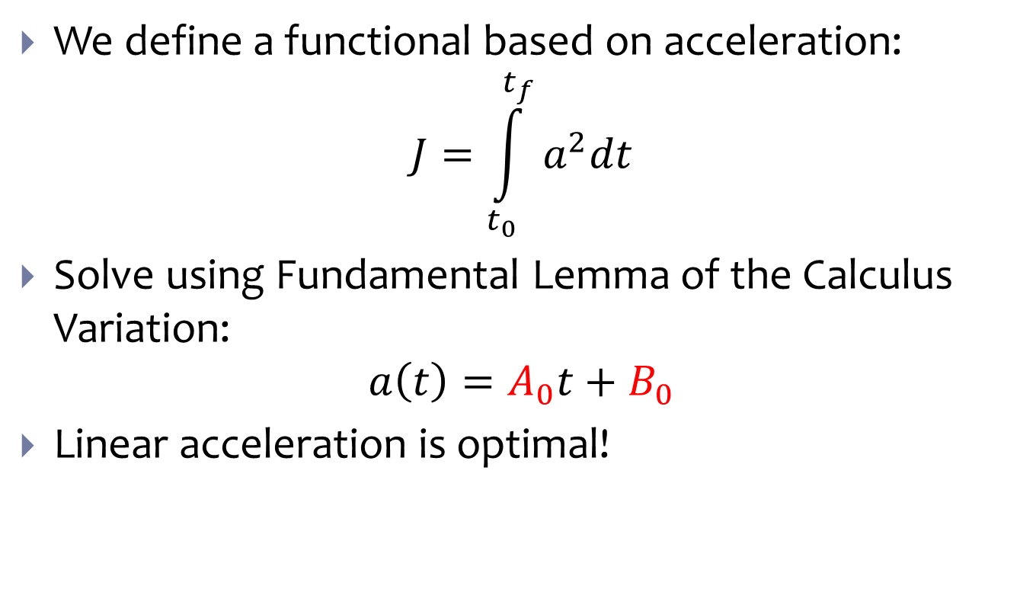
Find the Optimal Trajectory
We define a functional based on acceleration:
$$J=\int_{t_{0}}^{t_{f}}{a^{2}dt}$$
Solve using Fundamental Lemma of the Calculus Variation:
$$a\left(t\right)=A_{0}t+B_{0}$$
Linear acceleration is optimal!

Slide 16
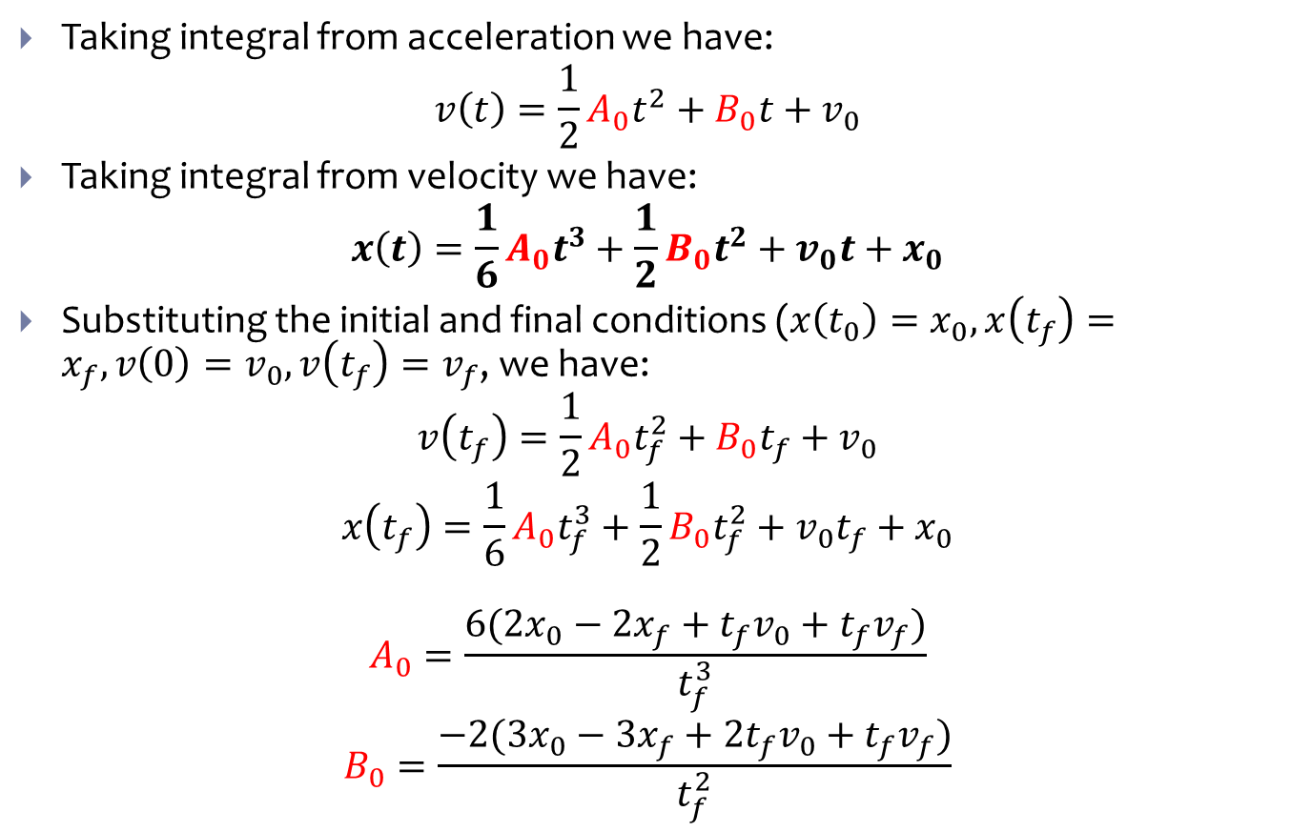
Find the Optimal Trajectory (cont.)
Taking integral from acceleration we have:
$$v\left(t\right)=\frac{1}{2}A_{0}t^{2}+B_{0}t+v_{0}$$
Taking integral from velocity we have:
$$x\left(t\right)=\frac{1}{6}A_{0}t^{3}+\frac{1}{2}B_{0}t^{2}+v_{0}t+x_{0}$$
Substituting the initial and final conditions (${x\left(t_{0}\right)=x}_{0}, x\left(t_{f}\right)=x_{f}, v\left(0\right)=v_{0}, v\left(t_{f}\right)=v_{f}$, we have:
$$v\left(t_{f}\right)=\frac{1}{2}A_{0}t_{f}^{2}+B_{0}t_{f}+v_{0}$$
$$x\left(t_{f}\right)=\frac{1}{6}A_{0}t_{f}^{3}+\frac{1}{2}B_{0}t_{f}^{2}+v_{0}t_{f}+x_{0}$$
$$A_{0}=\frac{6(2x_{0}−2x_{f}+t_{f}v_{0}+t_{f}v_{f})}{t_{f}^{3}}$$
$$B_{0}=\frac{−2(3x_{0}−3x_{f}+2t_{f}v_{0}+t_{f}v_{f})}{t_{f}^{2}}$$

Slide 17
Dealing with Round-trip Delay
As soon as TOA and VOA are received, the optimal trajectory is determined.
All determined trajectories will meet the TOA and VOA requirement.
Vehicles will control the position instead of velocity
Request Time

Slide 18
Feasibility of VOA and TOA
Is the assigned TOA and VOA feasible?
Min and max acceleration rates
Vehicles have limited acc/dec power
Min and max velocities
Road speed limit

Slide 19
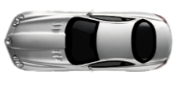
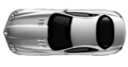
Feasibility of VOA and TOA
Request line

Slide 20
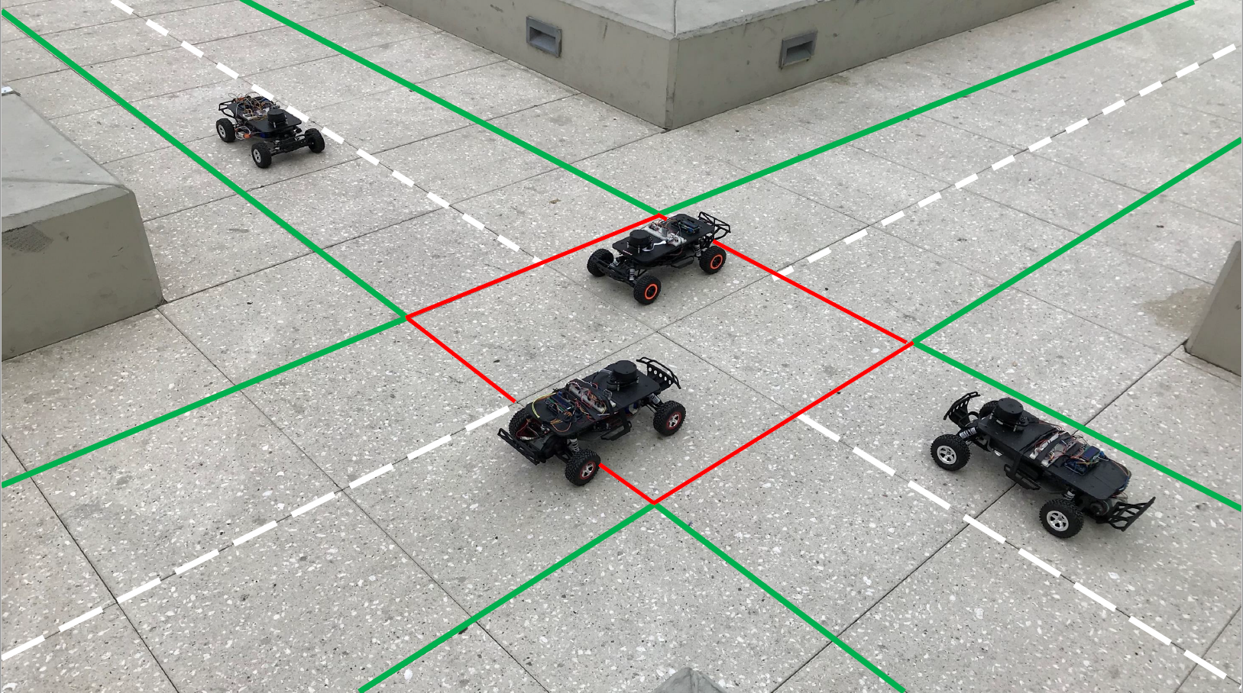
Our Testbed
4-way intersection
1/10 scale RC cars on Traxxas chassis
Vehicle size = 30 cm x 57 cm max speed = 5 m/s (11.1 mph)
Lane width = 60 cm
Transmit line distance = 3 m
NTP protocol for clock synchronization (10 ms accuracy)
PID controller for position trajectory tracking
3 types of communication packets
Sync (7 Bytes), Request (30 Bytes), Receive (30 Bytes)

Slide 21
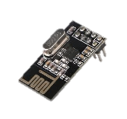
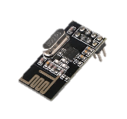
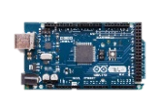
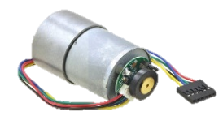
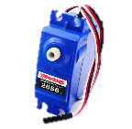
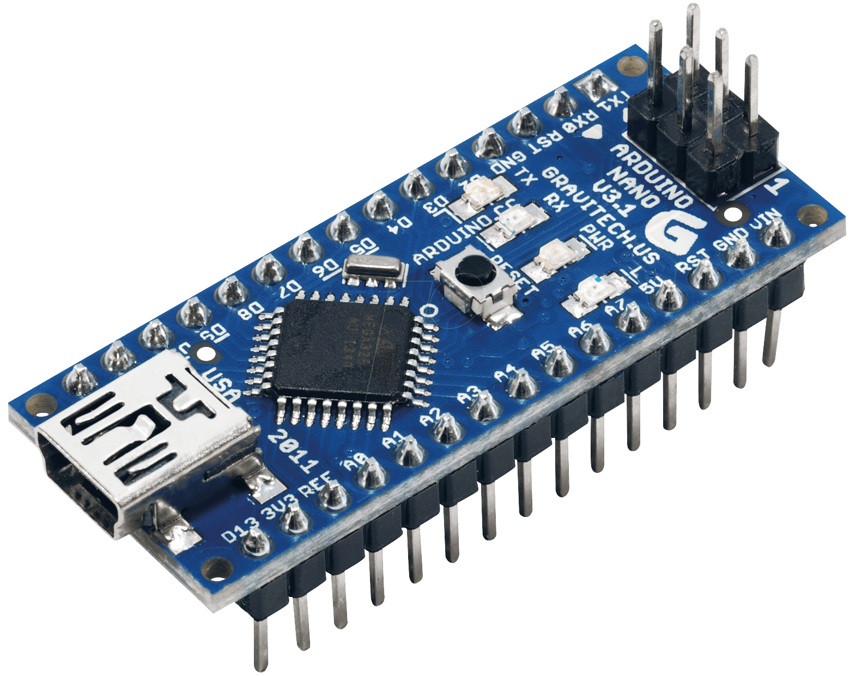
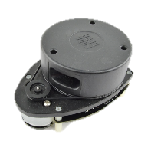
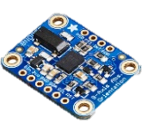
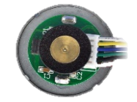
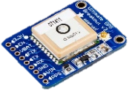
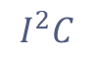
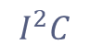
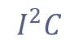
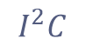
IM & Car Schematic
Wireless
IM uC
SPI
Transceiver
Transceiver
IM
Autonomous Car
SPI
Motor
PWM
Main uC
PWM
Servo
1st uC
$$I^{2}C$$
$$I^{2}C$$
$$I^{2}C$$
2nd uC
USART
$$I^{2}C$$
USART
Square Wave
LIDAR
IMU
GPS
Motor
Encoder

Slide 22
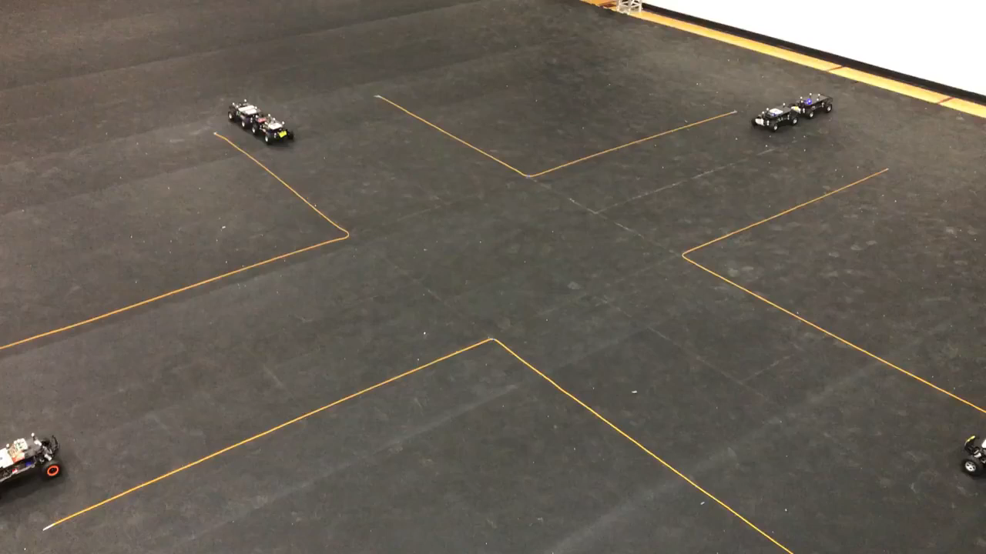
Video of Our Intersection

Slide 23
Crossroad Position Error
Position Error
10 % model mismatch is added.
An external disturbance of 5% is applied
Monitor position and velocity of a CAV.
Edge of the intersection
Actuation time
Model Mismatch Error
External Disturbance Error
Disturbance is applied

Slide 24
RIM is Robust
Almost zero error
10 % model mismatch is added.
An external disturbance of 5% is applied
Monitor position and velocity of a CAV.
Edge of the intersection
Disturbance is applied
Receive time

Slide 25
Robustness of RIM vs Crossroads
We repeated our experiment 50 times. For different VOA and TOA
3.3X!
14%

Slide 26
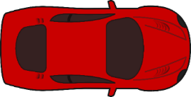
Crossroads needs a Safety Buffer
Since Crossroads does not consider model mismatches and external disturbances, it’s not safe!
However, Crossroads can still work if we consider a safety buffer of 3.3X of size of the car.

Slide 27
Evaluation using Our Simulator
Developed in MATLAB^{® [1]}
Scale to multi-lane intersection
Variable traffic flow rates
Model vehicle dynamics
Model network delay
[1] Available Online: https://github.com/mkhayatian/Traffic-Intersection-Simulator-for-Autonomous-Vehicles

Slide 28
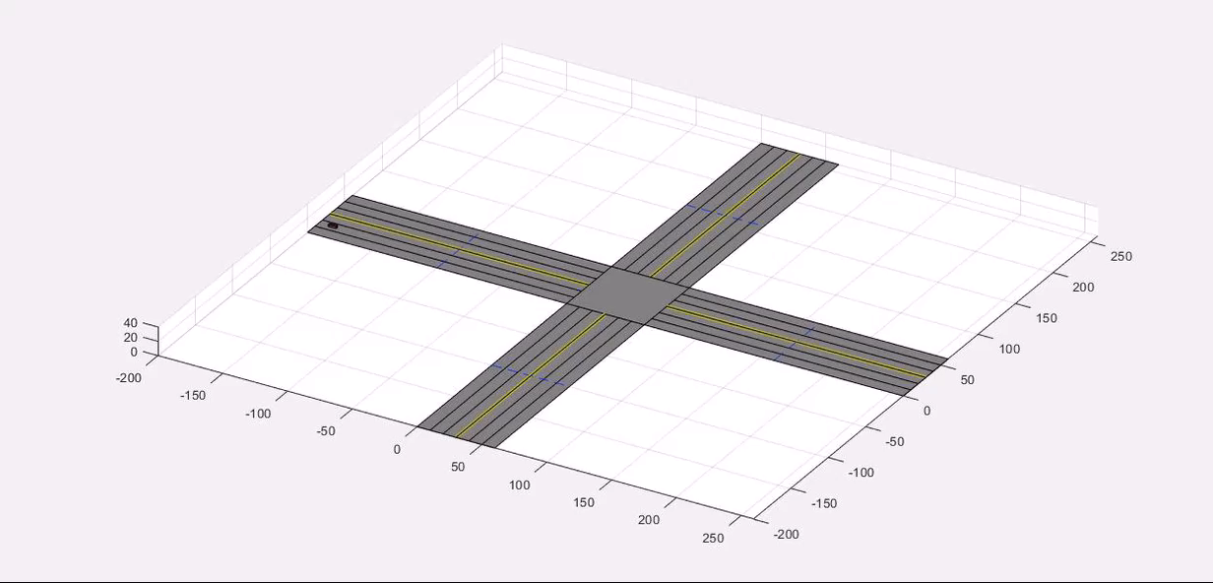
Simulator Video
Available Online: https://github.com/mkhayatian/Traffic-Intersection-Simulator-for-Autonomous-Vehicles

Slide 29
Throughput Improvement

Slide 30
Efficiently Making a Turn
Crossroads & VA-IM
A constant Velocity is assigned.
To avoid rollover, turn speed is low.
Vehicles that intend to make a turn will slow down behind vehicles.
RIM
Vehicles can adjust their speed.

Slide 31


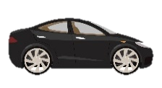
Position of Our Work
Query-based (AIM)
Velocity Assignment
Crossroads
RIM
QB-IM
VA-IM
Crossroads
RIM
Expected
Time of Arrival &
Velocity of Arrival
Current Velocity,
Position & Timestamp
Current Velocity & Position
Current Velocity,
Position & Timestamp
②
②
②
②
Accept or Reject
①
①
Assigned Velocity & Actuation timestamp
①
①
Assigned Velocity
Time of Arrival & Velocity of Arrival

Slide 32
Conclusion
We explored safety concerns of previous intersection management techniques.
Network delay
Vehicle dynamics
We presented a robust intersection management interface for connected autonomous vehicles.
Model mismatch
External disturbances
Efficient

Slide 33

Question?
This Photo by Unknown Author is licensed under CC BY-SA

Slide 34
Finding with WCRTD
Timeout when delay is large and stop the vehicle.
Not working is better than causing an accident!
Usual delay
Timed out
Selected Threshold

Slide 35
Round-trip Delay
The Worst-case RTD = WCET + WCND
Worst case network delay in the forward and backward paths
Worst-case execution time of the IM
WCND
Nondeterministic (theoretically infinite!)
WCET
Measurement-based methods (No guarantee)
Static methods (pessimistic)
Therefore, WCRTD cannot be determined and compensated!

